Slide 1
TEOA Product Marketing Standard Work
November 21, 2019 – Product Management Council

Slide 2
TEOA Product Marketing Standard Work
Why is Marketing Now Adopting This?
Extending current NPI process to include all types of product promotion (new and existing) and new available channels (E-commerce, Select).
Drive efficiency and consistency in product promotions across all BUs.
Provide a consistent experience in how marketing partners with PMs
Value?
Marketing, with Product Management, can ensure higher quality content.
Targeting the right segments, focused on commercial priorities.
Impact on Product Management?
Success requires close partnership between Marketing and Product Management, we require your continued commitment and buy-in.
Specifically, three process refinements will drive stronger and more consistent communication:
Strategic Alignment
Product Briefing
Content Development

Slide 3









TEOA Product Marketing Standard Work Team
DECISION BOARD MARKETING COUNCIL
WORKSTREAM ADVISOR /// SARA CORREA
PRODUCT MARKETING STANDARD WORK TEAM
CHRIS YEADON
Manager
Product Marketing
Automotive
MEGAN FRAIN
Manager
Integrated Marketing
Sensors
CERIES MINNICH
Analyst
Product Marketing
Appliances
JEN NAGY
Analyst
Product Marketing
IND
LAUREN WAY
Manager
Product Marketing
DND
ROBIN BOCK
Analyst
Integrated Marketing
ICT
TERESA WILSON
Analyst
Integrated Marketing
ADM
LORI LYONS
Analyst
Integrated Marketing
Energy

Slide 4
Objectives
BUSINESS
Time efficiency
Harness collective resources and knowledge
Reinforce a ‘one TE’ face to the market
Continuous improvement
WORKSTREAM
Define process steps for product promotion
Define deliverables for process steps
Execution of deliverables for process steps
Identify and/or develop tools and resources
Identify KPIs to measure activity success
MARKETING
Drive consistency in core marketing activities
Establish processes that are standard yet flexible
Alignment to the standard product promotion process
Team. Charter. Objectives. | Knowledge Share. Steps Definition. Best Practices Alignment. Process Development. | Marketing Council Initial Review. | Complete Process. Definitions. Finalize Tools. Test & Review. | Marketing Council Final Review. PM Council. | Finalize Edits. Communication. Implementation. Continuous Improvement.
APRIL | MAY – JULY | AUGUST | SEPTEMBER – OCTOBER | NOVEMBER | DECEMBER – JANUARY

Slide 5






Our Methodology
KNOWLEDGE SHARING
Processes
Channel, E-Commerce, Select
Experiences
Ideas
Examples
Colleagues
STANDARD WORK DEVELOPMENT
Workshops
Breakout Teams
Cross-functional Input
Workstream Advisors
RESULTS
Aligned Best Practices
Tools & Resources
Process Consensus
Adoption
CONTINUOUS IMPROVEMENT

Slide 6
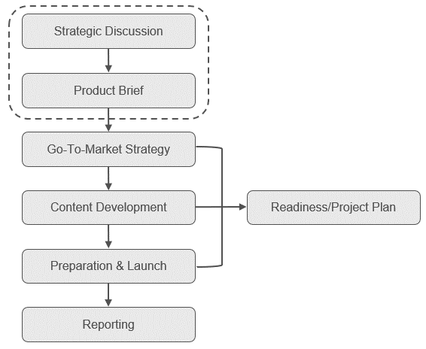
Product Marketing Standard Work Process Steps
Strategic Discussion
Determine launch type, scope, priority and tactics for product campaign.
Product Brief
Obtain sufficient technical and business information from PM to formulate value proposition and base-line marketing content.
Go-to-Market Strategy
Communicate campaign strategy based on objectives, product type, channels and target audience.
Content Development
Develop core content assets and messaging to be used for product campaign.
Readiness & Planning
Create detailed project plan including readiness, marketing content, digital content, launch activities and budget.
Preparation & Launch
Deployment of content and assets for internal and external communications and promotion.
Reporting
Product campaign reports summarizing highlights and performance of tactics and activities. Post-launch process for follow-up and action.

Slide 7

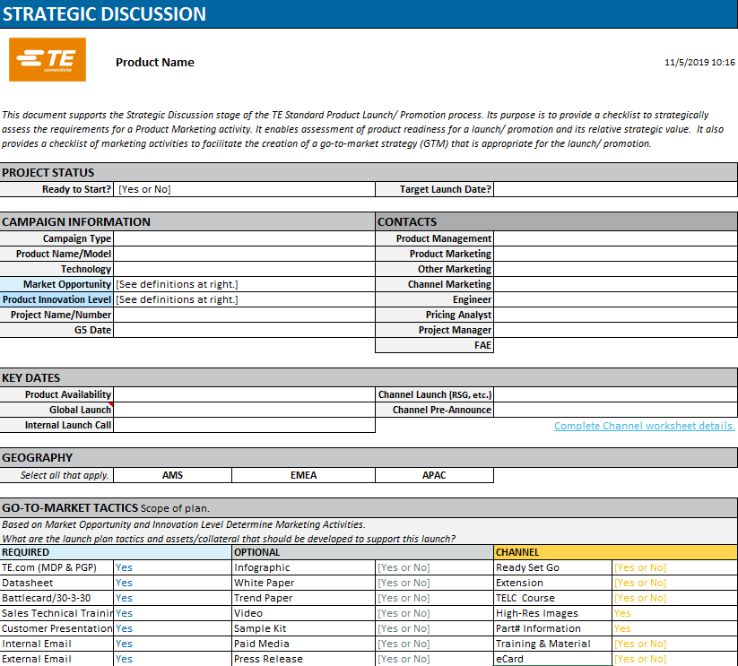
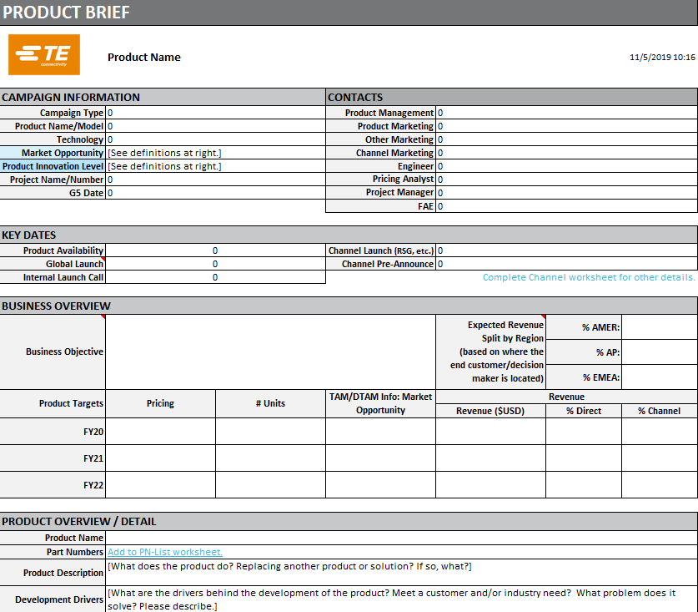
Standard Work Tools Examples
Product Marketing Workbook
Strategic Discussion Template
Product Brief Template

Slide 8



Reporting KPIs Mandatory Scorecard Metrics
 | On-Time Launch Deliver within agreed upon launch date (±30 days) with Product Management, date established during project kick-off. | On-Time: Yes/No Launch Delayed Due to Marketing Launch Delayed Due to PM/Enterprise
 | Leads Drive quality leads and marketable contacts. | Total # Leads % MQL Conversion
 | Revenue Drive financial success for product internally and with external partners. | Revenue Targets Met (1 year/3 year)? Channel Launches: POP, POS Growth
CONSIDERATIONS
Marketing not always in control of launch date, dependencies on other functions are significant.
Marketing not responsible for setting revenue goals.
Not all BUs have ability to accurately track leads, revenue.
Notes:
Connect our KPIs to success of launch – financial depends on good business overview and objectives from PM

Slide 9
What is our ask of the PM Council?
Reinforce with your teams the quality of a product promotion is directly tied to the level of partnership and collaboration that Marketing and Product Management have early in the process.
Approval and support of Product Marketing Standard Work
Expect Marketing to be an early collaborator and partner that brings opportunities and content recommendations to you and your teams
Provide timely, complete and value focused input on Strategic Discussions
View the product promotion process, and the associated standard work, as a tool to drive closer alignment and partnership between our functions

Slide 10
Thank You. Questions?
TEOA Product Marketing Standard Work

